Slide 1
Operations Research
CSC 434
Lecture 4
Oluwambo Olowe

Slide 2
Solution of Linear Programing problem - Graphical Method (for Two Variables)
Steps Involved
Define the decision variables.
Formulate the objective function.
Write down the constraints.
Convert inequalities to equations and plot them on a graph.
Determine the feasible region that satisfies all constraints.
Find the corner (vertex) points of the feasible region.
Compute the objective function value at each vertex.
The maximum (or minimum) value gives the optimal solution.

Slide 3
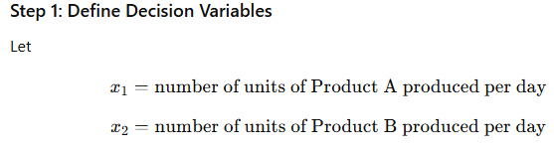
Example 1 - Maximization Problem
A company produces two products: A and B.
Each unit of A requires 2 hours of machine time and 1 hour of labor, while each unit of B requires 1 hour of machine time and 3 hours of labor.
The company has a total of 8 machine hours and 9 labor hours available per day.
Profit per unit is ₦3 for A and ₦5 for B.
Find how many units of A and B should be produced to maximize profit.

Slide 4
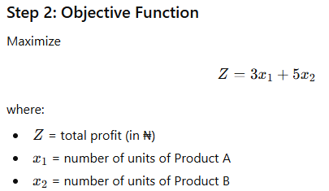
,

Slide 5
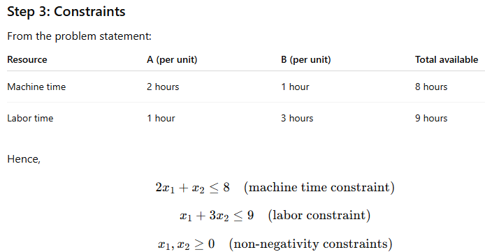
,

Slide 6
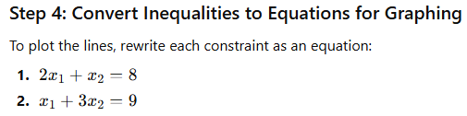
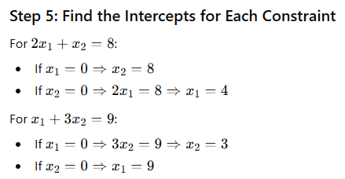
,

Slide 7
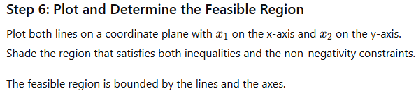
,

Slide 8
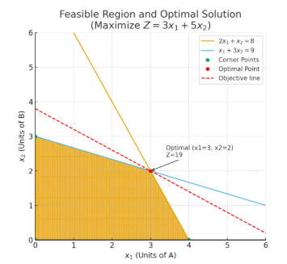
,
.

Slide 9
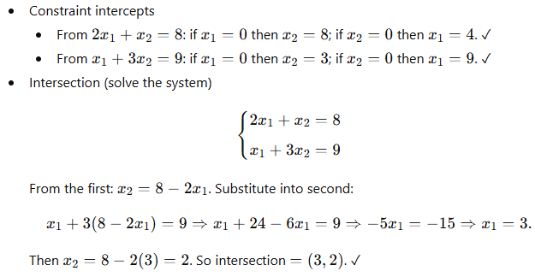
,

Slide 10
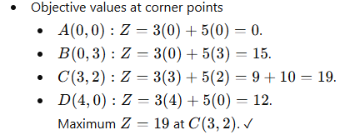
,
,

Slide 11
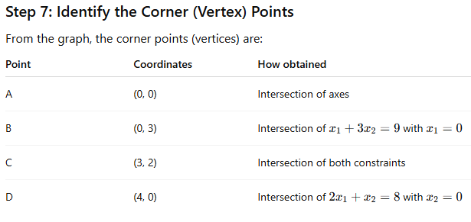
,

Slide 12
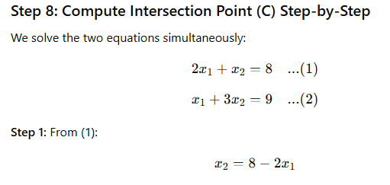
,
.

Slide 13
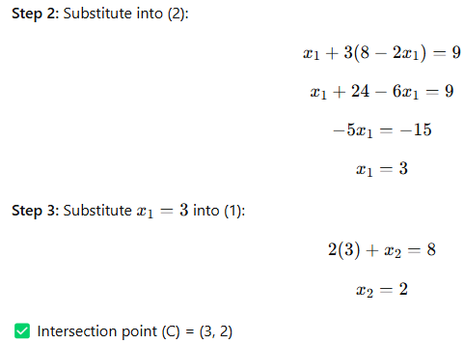
,
,

Slide 14
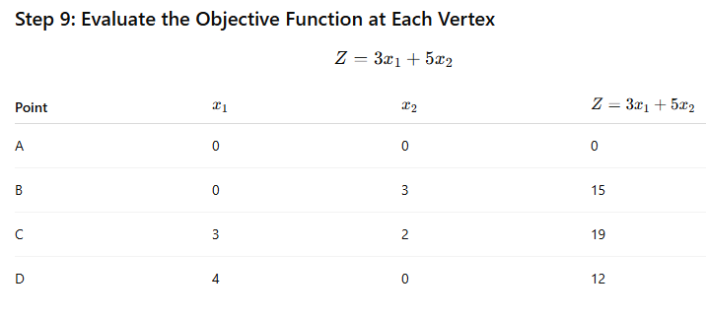
.
,

Slide 15
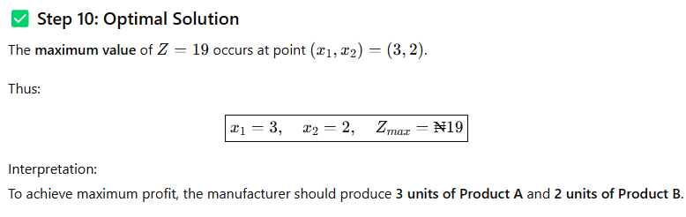
,

Slide 16
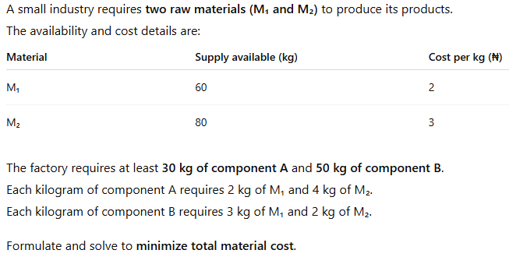
Example 2: Minimization Problem

Slide 17
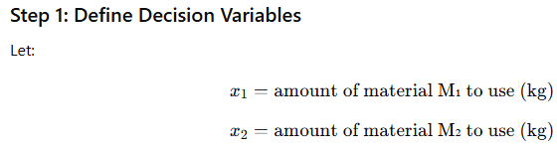
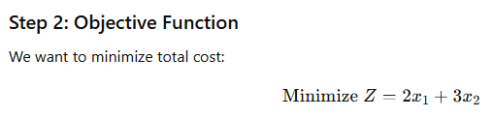
,

Slide 18
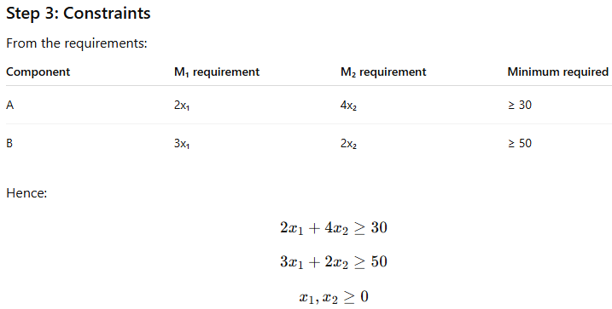
,

Slide 19
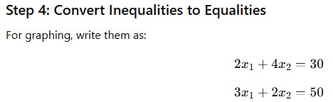
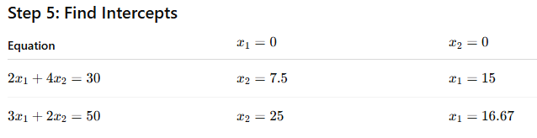
,

Slide 20

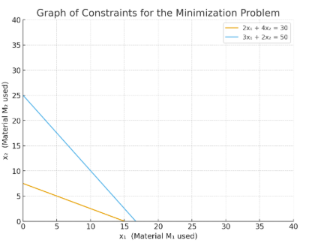
,
,

Slide 21
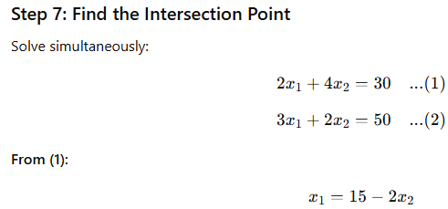
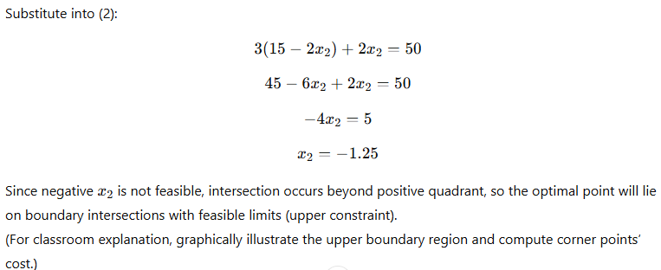
,

Slide 22



